Slide 1
Our call for Sufficiency
Fe’iloakitau Kaho Tevi
General Secretary
Pacific Conference of Churches

Slide 2
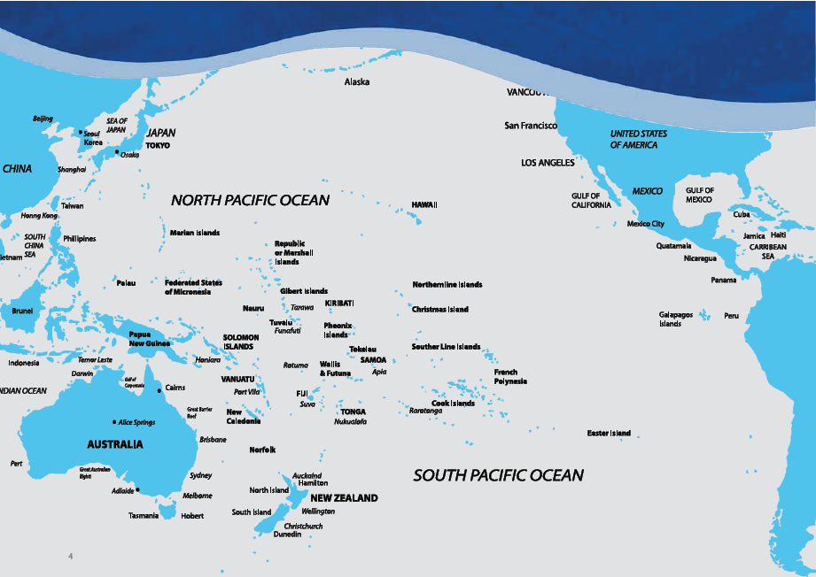
Notes:
1. 165.2 million sq.km or half the world’s ocean area or a third of the earth’s total surface area
2. 56 Pacific Island and Rim Countries and Territories & over 25,000 islands
3. Population of 2.9 billion
4. Combined Economic value of US $34.7 trillion, or 57% of global GDP
60% of total global tuna catch
SCALE – Niue 1700 people – 350,000 sqkm of ocean
- kiribati 100k people – 3.5msq k of ocean
Called the liquid continent fitting all 5 continents into the Pacific Ocean

Slide 3
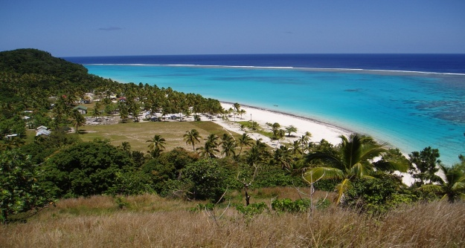
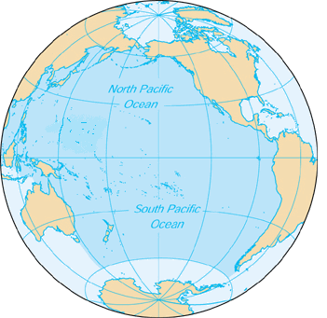
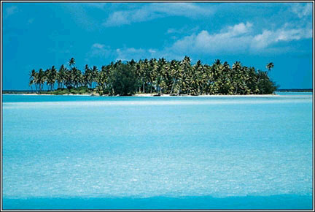
The Liquid Continent: Quick & Random
The Pacific Ocean, otherwise known as the liquid continent, covers a third of the earth’s total surface area.
176 millions sq km whereby only 10 million are land.
There are about 25,000 islands in the Oceania with only 20% inhabited.
The Pacific Ocean area is greater than that of all the world's land masses combined.
Sub regions in Oceania: Micronesia, Melanesia, Polynesia.
There are an estimated 2500 languages and dialects in the Oceania region.
90% of population are Christians, due to the arrival of the foreign missionaries in the late 19th and early 20th centuries.
Pacific Conference of Churches:
27 member churches
9 National Councils of Churches in 14 PICs, 2 French Territories & FSM
Representing approx 5.6 of the region’s total population of 8.2 million people.

Slide 4
Understanding development...
We are more than what we consume...
Scepticism on models and indicators
The strait jacket of development and growth
Mainstreaming “more is better”
When is enough, enough?
Towards the notion of sufficiency
Towards a new understanding of economic growth..going local...
Notes:
The neo-liberal economic ethic, which drives much of our economic thinking and policies today, is the direct opposite of our ideal value of sufficiency.
The question is: which of the two will make our people happier – the consumerist idea of “more and more” or the idea of sufficiency
The question “when is enough, enough?” then becomes a fundamental issue in the type of development model in operation in most of our island states
This is partly due to the exponential growth developmental model that most of our island states adopted over the past 40 years, and partly due to the economic ideology that accompanied it: development means more and more economic growth.
The end result is that most of our Pacific island states are told to undertake political and economic reforms in the mistaken belief that what we had and which served our countries and islands for centuries in terms of political governing systems, community developmental models and social security processes cannot deliver the required “growth”; there is simply no room for alternative thinking.
Pacific Plan developmental indicators in most of our island states are showing worsening levels of poverty and inequality
What has not been highlighted nor mainstreamed are the local economic and ecological initiatives that are developed from within the local communities such as environmental conservation projects by villages, “green” developmental projects by churches, as well as an alternative financial system such as the kastom ikonomi of Vanuatu.
In many of our countries, we note the disproportionately large percentage of our population in the “informal” and agricultural sectors:
Vanuatu: 82%
Fiji: 40%
Go local , eat local....promoting local sufficiency... Crest Agricultural show
It needs to be recognised that “more is better” is contingent on mainstreaming the idea of “individualism” and reducing or marginalising the idea of “community”
Needless to say, that fundamental to any development of economic alternative is the question of sufficiency in regards to the fulfilment of basic needs and healthy regard of the ecology, and solidarity as it relates to sustaining community life and relationships.

Slide 5
Climate Change
CC: clearest evidence on fallacies of the current economic model.
CC: questions our sense of continuity and permanency
Threat to entire eco-systems
Threat to resources due to over-exploitation
Human Beings have become a threat to their own environment.
Notes:
Climate change and its impacts is fuelled by a view of development that pays no regard to the health and well-being of both our human economy and our natural ecology.
Climate Change is the clearest evidence that the current economic model we adopted for our development is unsustainable. This economic growth model clearly does not work to the betterment of our people and the environment.
Even more so, the potential to wipe an entire ecosystem is very real and with it the notion of human community and common identity. There are fundamental principles that speak to, and remind us of our humanity, and some of these are the sense of continuity and permanency.
Experts, citing the examples of such countries as Bangladesh and parts of China, Indonesia and Vietnam, have said that millions of people in densely populated, low-lying, developing countries might be forced to move by rising sea levels.
For some of our atoll nations, it is not only the loss of land and infrastructure as well as impacts on health but most disturbingly, the loss of identity, self-determination, and the social networks that give meaning to who they are as a people
Issue of Australia: COP15 and leadership of the Forum
One of the key challenges to our Pacific island states in 5 to 10 years time is the resettlement of populations due to sea level rise. The solution to this impending issue lies with us in the Pacific and it is imperative that regional discussions on this should urgently begin among our Pacific leaders

Slide 6
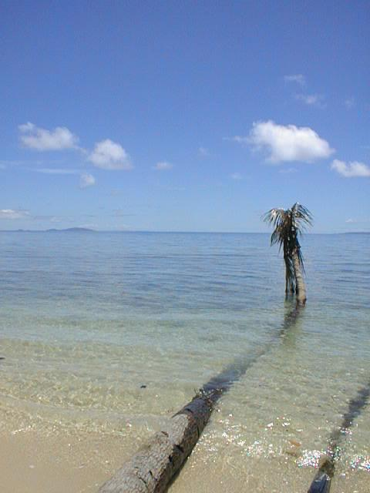
The reality of climate change
SEA-LEVEL RISE
Global sea level rose by an average of 15 cm between 1890 and 1990.
Sea level rose 4.3 cm between 1993 and 2007.
Global sea level is projected to rise as much as 120 cm between 1990 and 2100.
Maybe a nine-fold acceleration.
From IPCC 4th Assessment Report, 2007 [B2 and A1F1 scenarios] and 2009 revisions

Slide 7
Climate-change challenges for the 21st century in the Pacific Islands
Droughts, floods & changing rainfall patterns
Extreme weather events (storms, floods)
Rising sea level (1- 2 meters in this century)
Decreasing fish population, coral destruction
Loss in biodiversity (20-30% loss in species at increase in temperature of 2° C)
Reduced biomass production in particular in tropics/subtropics
Impacts on Traditional Knowledge
Continued El Niño (drought-producing) events every 3-5 years

Slide 8
Resettlement (relocation)
The need for an individual or community to move from a highly vulnerable location to a less vulnerable one.
This need is based on the belief that the highly vulnerable location where an individual or community is located today will become more vulnerable in the future (not less so).
So the biggest challenge at the moment surrounding this issue is denial and fear of moving to a new location.

